Slide 1
Strength of Materials
Module 5 – Beam
(Deflection in beam)
Dr. G.Venkatachalam
Professor / SMEC
VIT Chennai Campus
Chennai

Slide 2
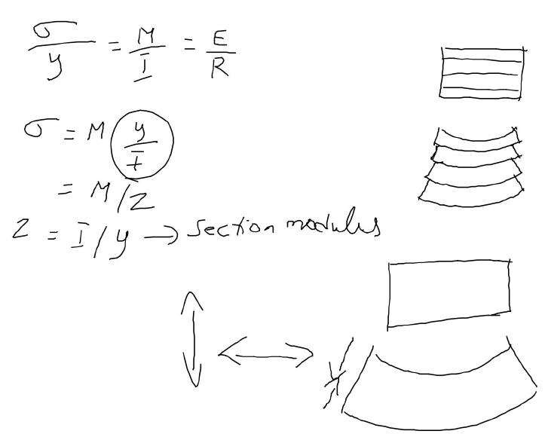
To be used in deflection of beam

Slide 3
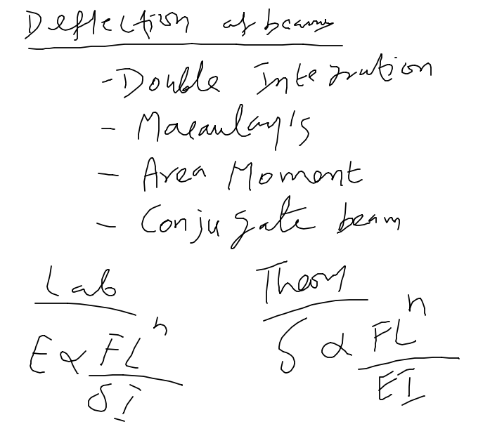
Methods to be used to find deflection

Slide 4
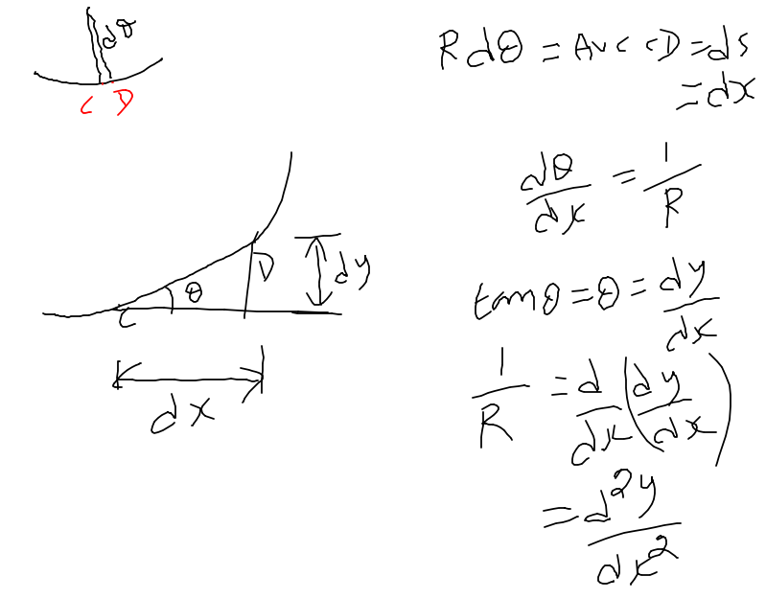
Curve CD enlarged

Slide 5
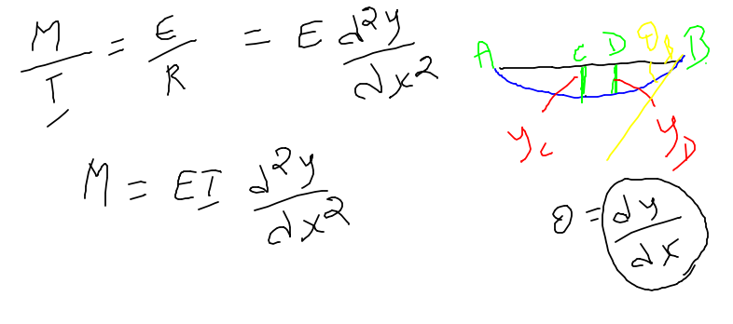


2nd order - Moment
1st order – Slope (or rotation)
0th order – Deflection (or translation)

Slide 6
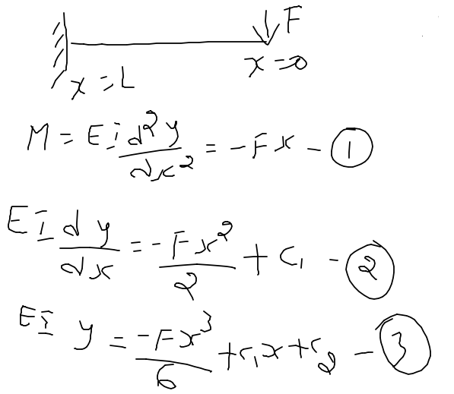
Double integration method
Cantilever beam with a point load at free end
Why we have not started from SS beam with a point load at middle???

Slide 7
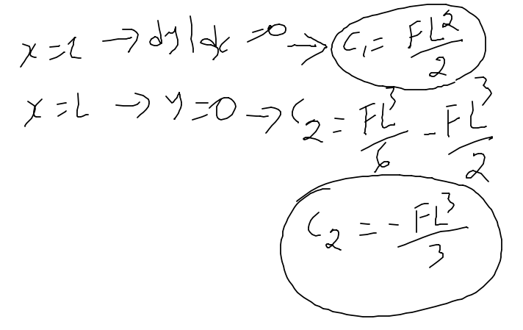
C₁ and C₂ are obtained by using boundary conditions..
Values of C₁ and C₂ are substituted in equations 2 and 3 given in previous slide..

Slide 8
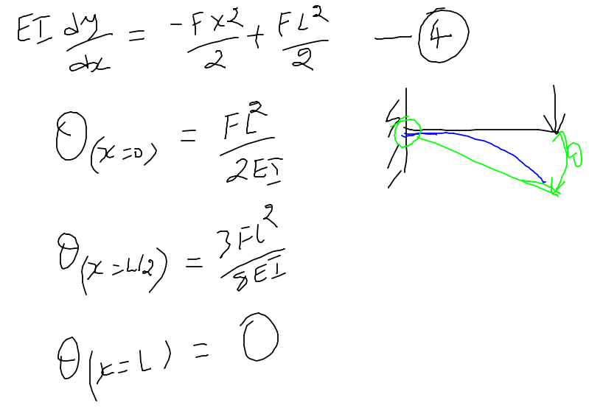
Equation 2 becomes equation 4 after substituting C₁ ……

Slide 9
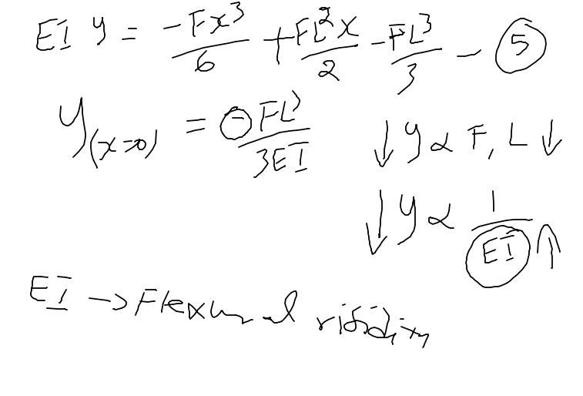
Equation 3 becomes equation 5 after substituting C₁ and C₂ ……

Slide 10
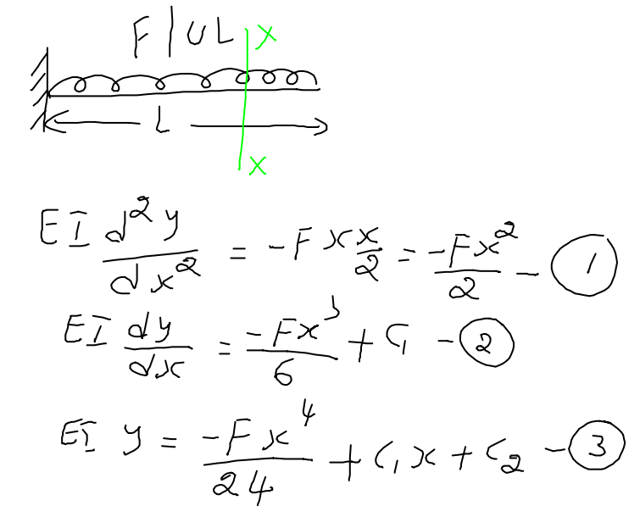
Cantilever beam with UDL

Slide 11
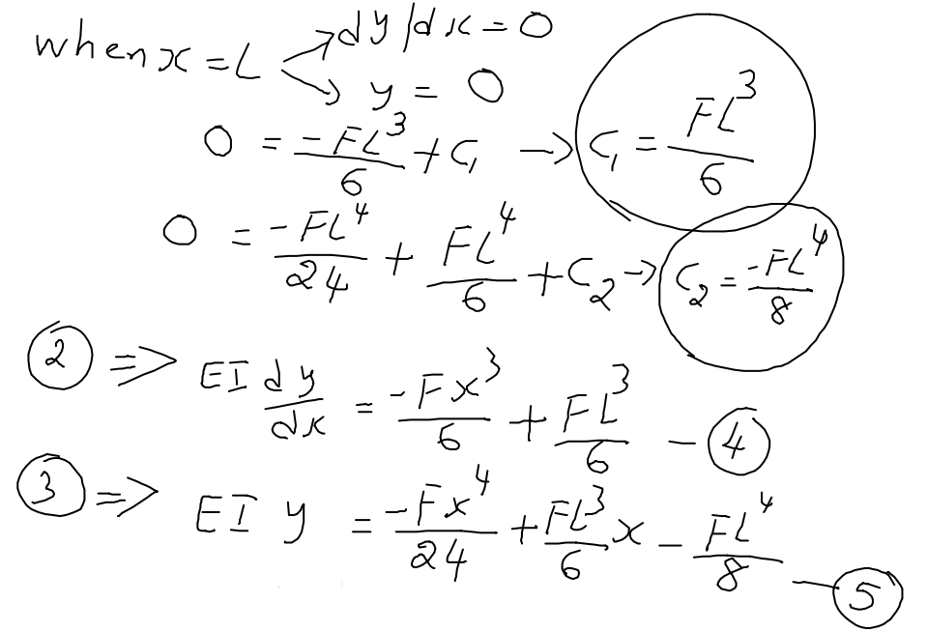

Slide 12
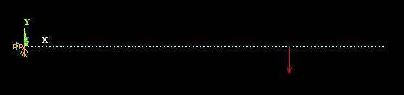
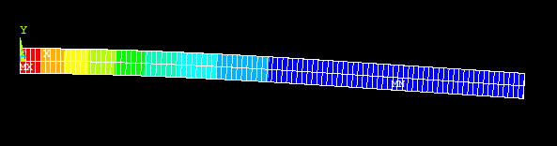
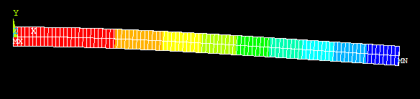
Cantilever beam with point load acting inside beam (not at free end)
How to solve?? How it is different from previous one??
Slope – no difference in slope from loading point to right end
Deflection

Slide 13
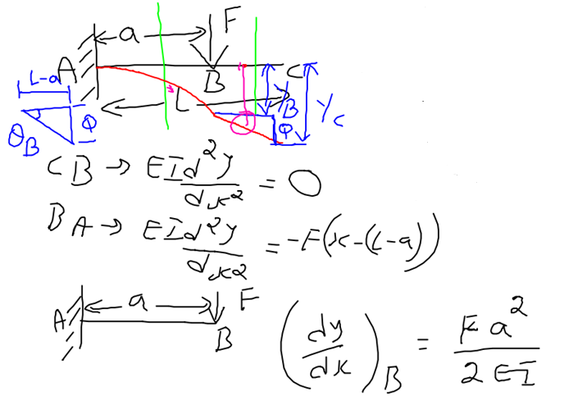
Cantilever beam with point load acting inside beam (not at free end)
How to solve?? How it is different from previous one??
Assume that beam length is “a” – only ‘AB’ is considered

Slide 14
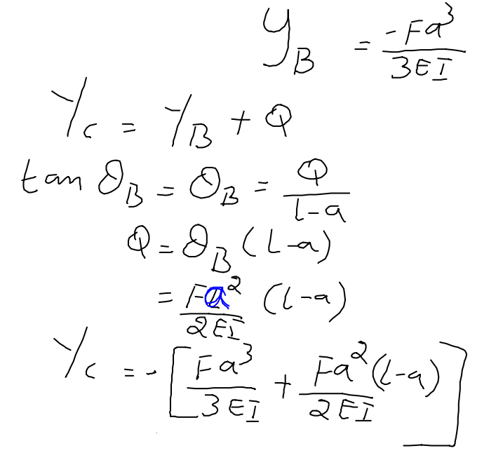
BC is free of load -‘θ’ is same from B to C
Steps to find Y_{c}

Slide 15
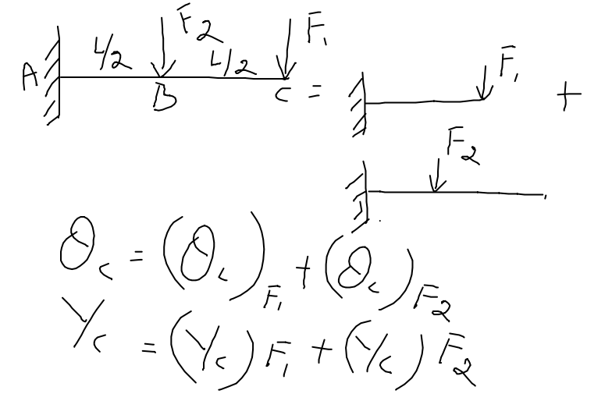
Cantilever beam with 2 point loads- superimposing results of F₁ & F₂
Slides 6 to 9
Slides 12 to 14

Slide 16
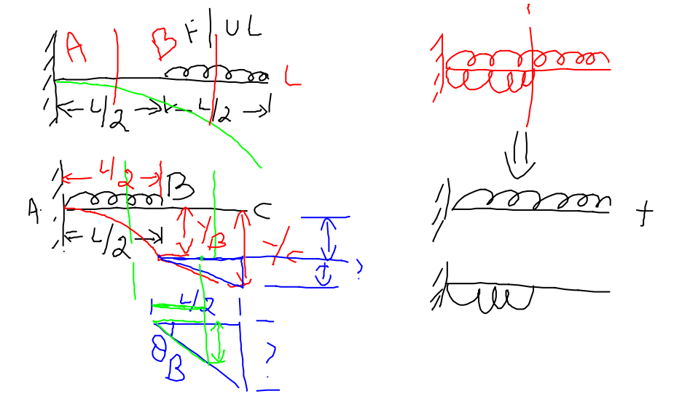
Cantilever beam with UDL applied over portion of beam

Slide 17
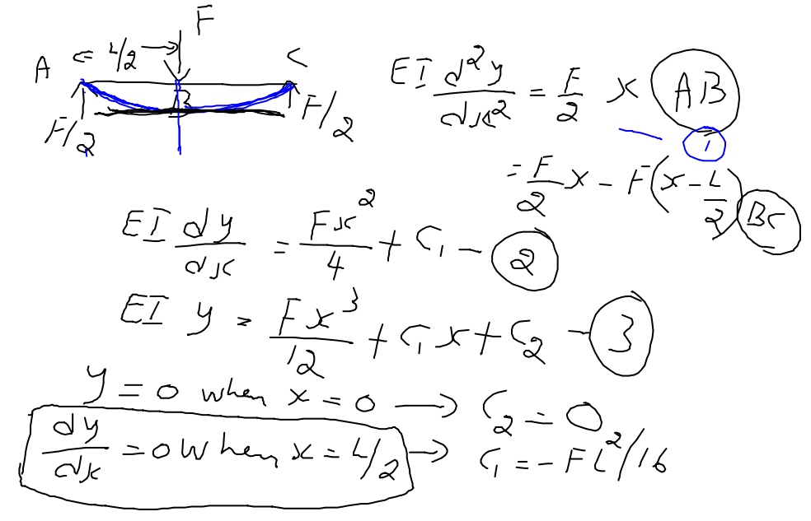
Simply supported (SS) beam with a point load at middle
Moment equation is not continuous i.e. not same for all regions – limitation of double integration
Only left half is considered

Slide 18
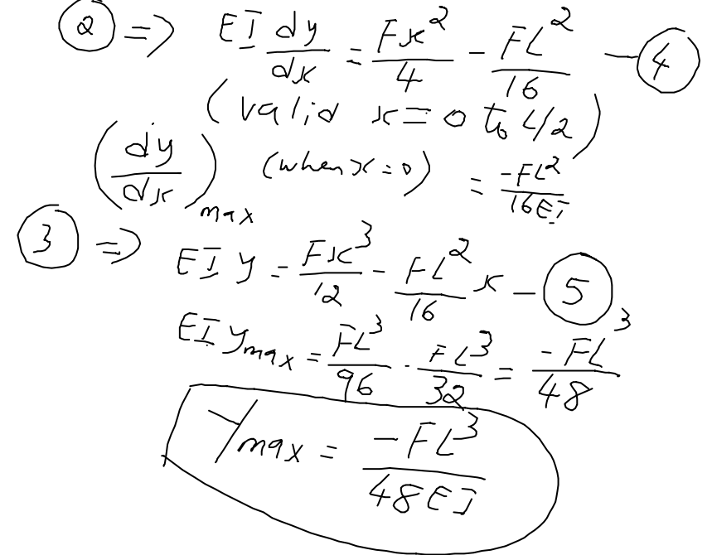

Slide 19
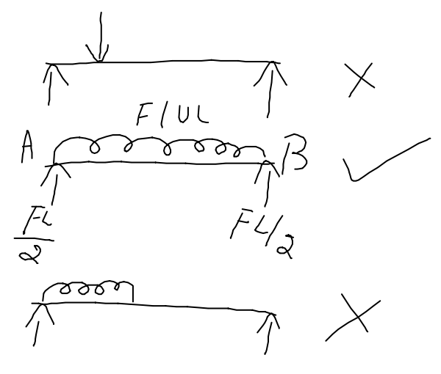
Can double integration be applied for following cases???
If point load is not at middle……
If UDL is applied only over a portion……
If not, what is other option??

Slide 20
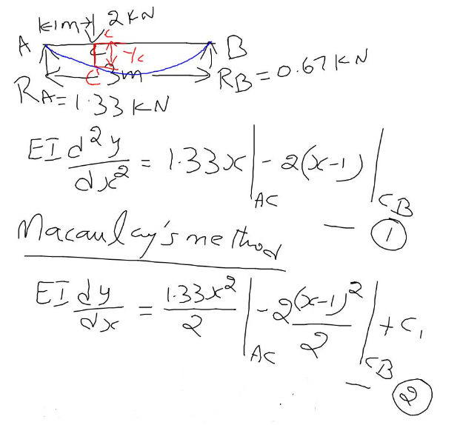
Macaulay’s method
Simply supported (SS) beam with a point load not at middle
In equation 1 – only first term for portion AC; both terms for portion CB
How integration of (x-1) is carried out?? – point to note

Slide 21
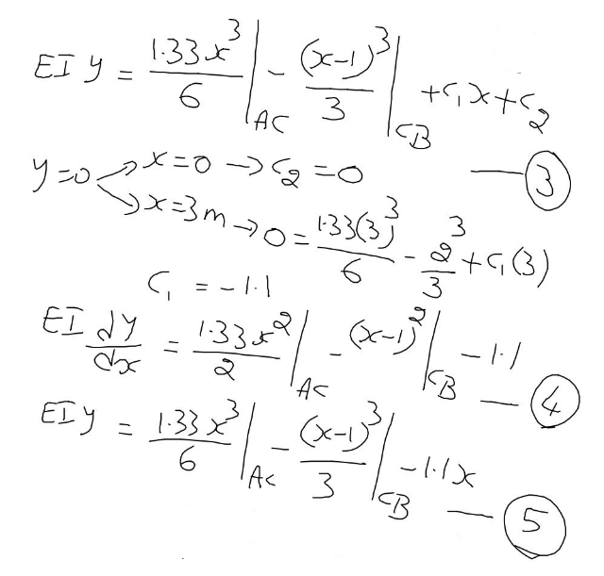
While finding C₂, term pertaining to CB is excluded. Why???
In equations 4 & 5 – only first & 3rd terms for portion AC; all terms for portion CB

Slide 22
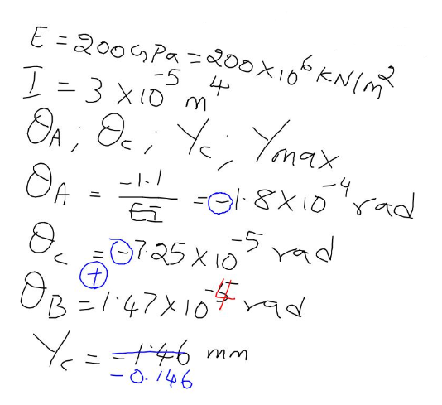
Force is taken (kN), hence E is kN/m²
θ Sign changes from C to B – so zero slope is between C and B – hence Y_{max} is between C and B. Y_{c} is not Y_{max}.
Using equation4, find the location of zero slope – substitute that ‘x’ value in equaion 5 – that is Y_{max}.

Slide 23
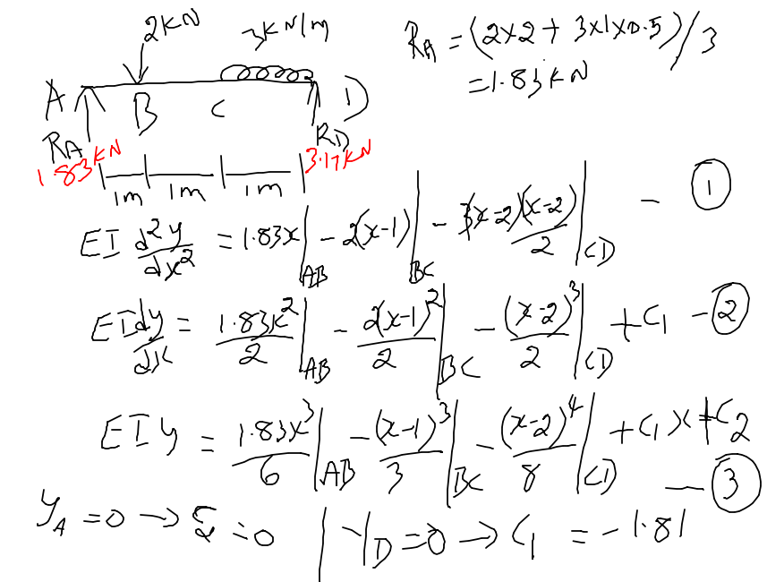
Simply supported (SS) beam with a point load and UDL

Slide 24
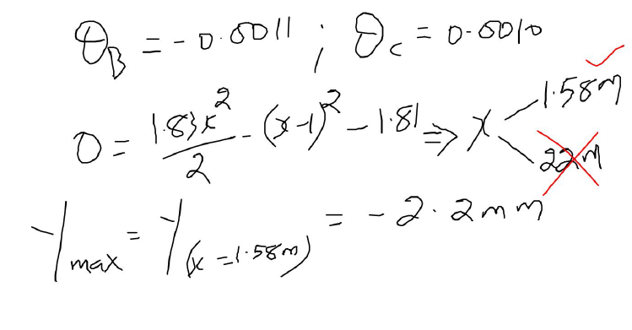

Slide 25
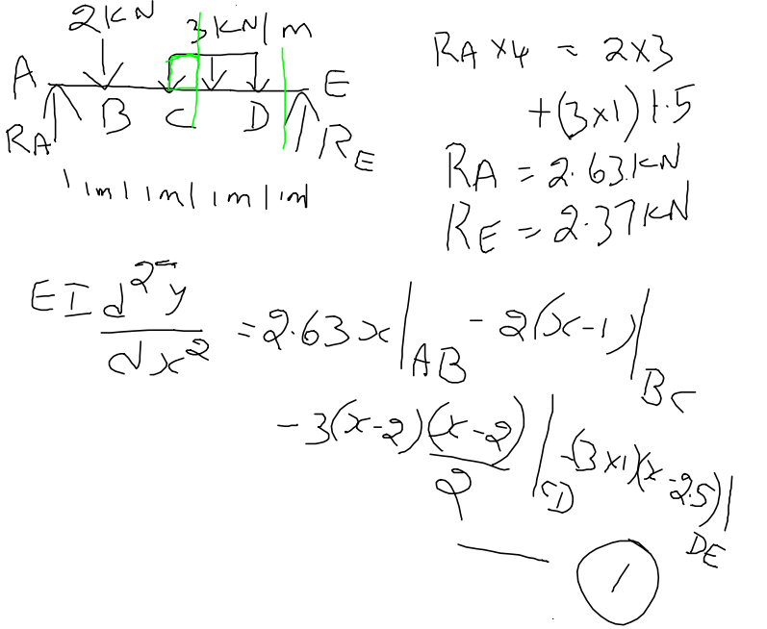
Simply supported (SS) beam with a point load and UDL

Slide 26
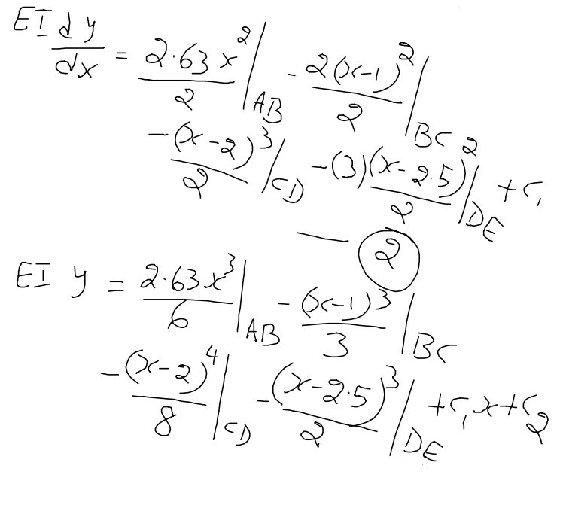
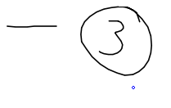

Slide 27
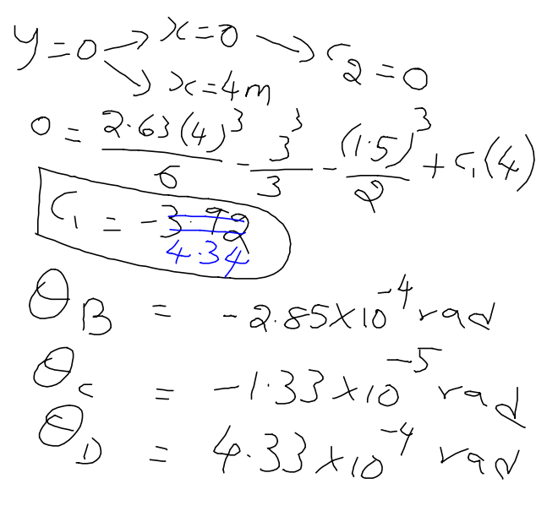

Slide 28
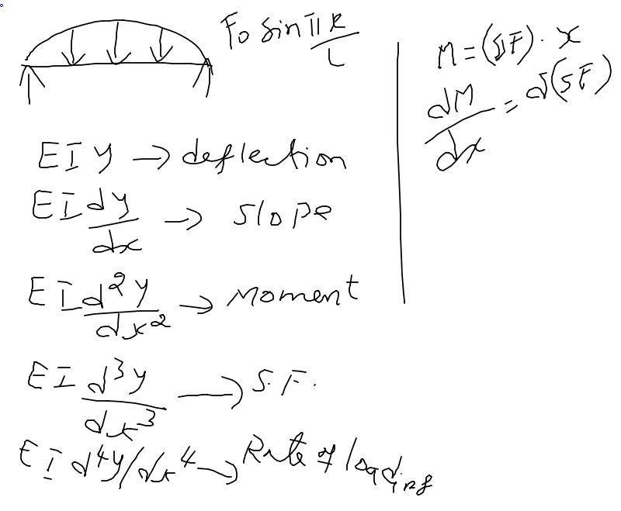
If loading is defined by “RATE OF LOADING”…..
So we have to start with 4th order differential equations

Slide 29
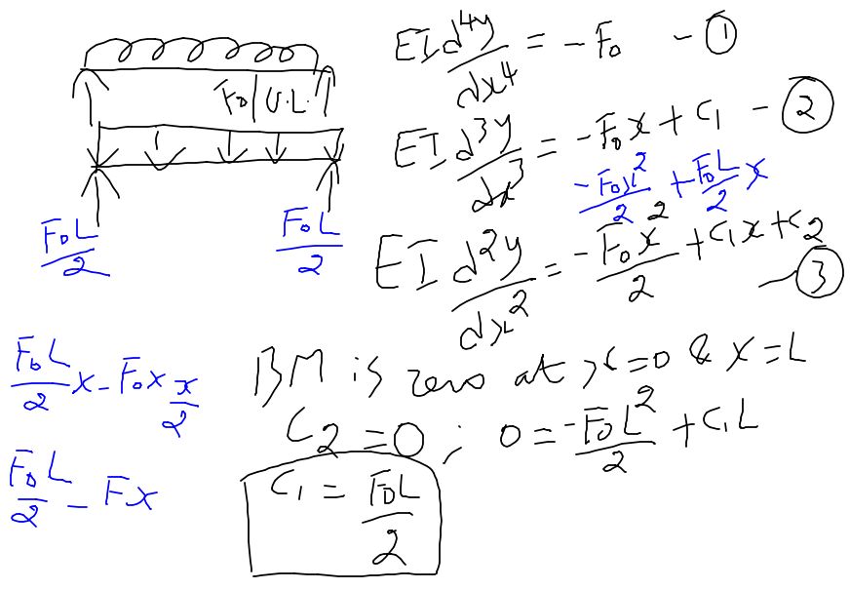
After substituting C₁ and C₂ in equation 3, we can follow the double integration as discussed previously.

Slide 30
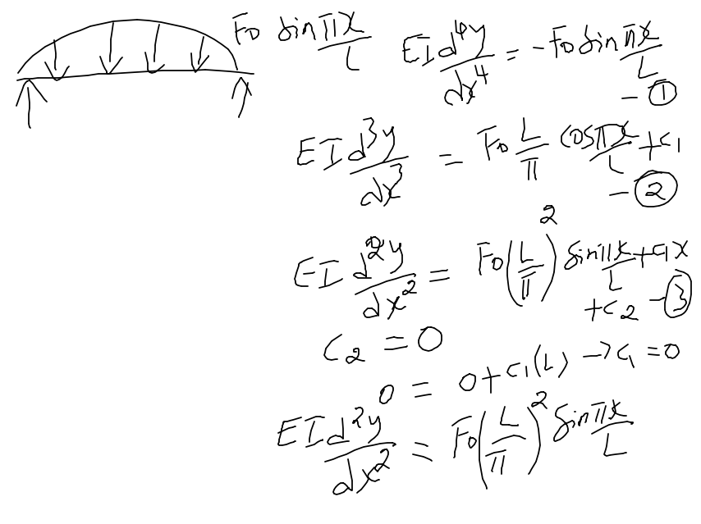

Slide 31
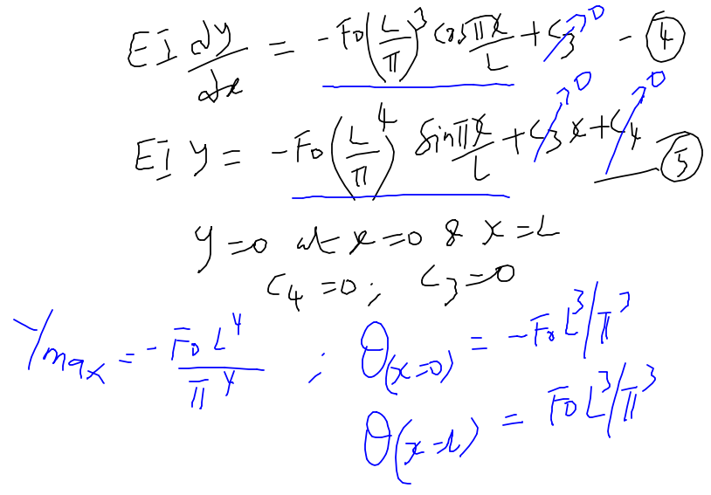

Slide 32
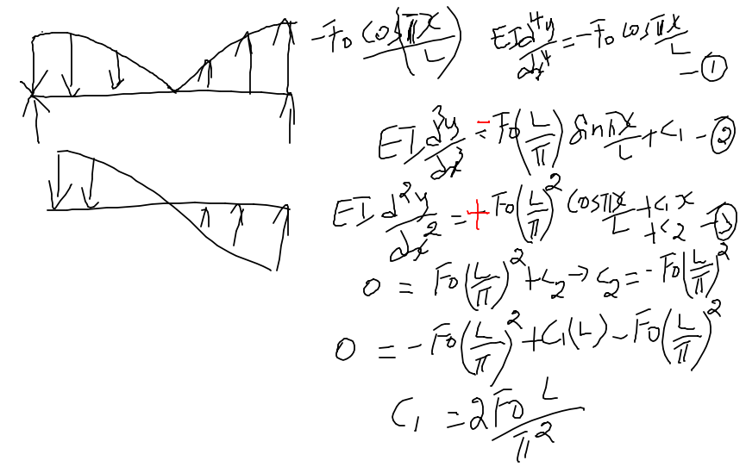

Slide 33
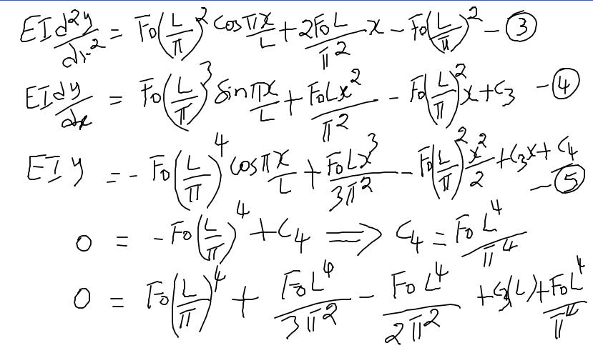

Slide 34
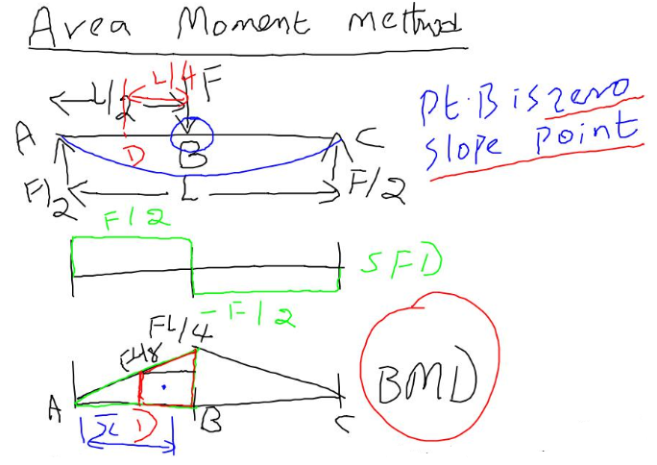
2 important things for this method – Bending moment diagram (BMD) of any given beam & Location of zero slope
* Area of any geometry
* First moment of area of any geometry

Slide 35
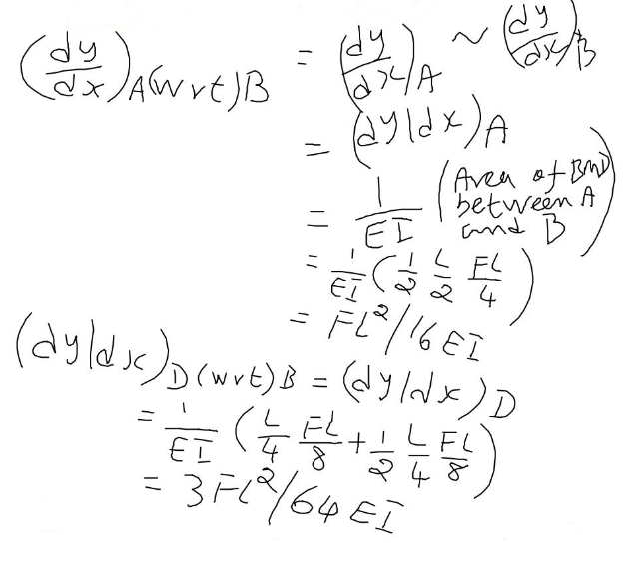

Slide 36
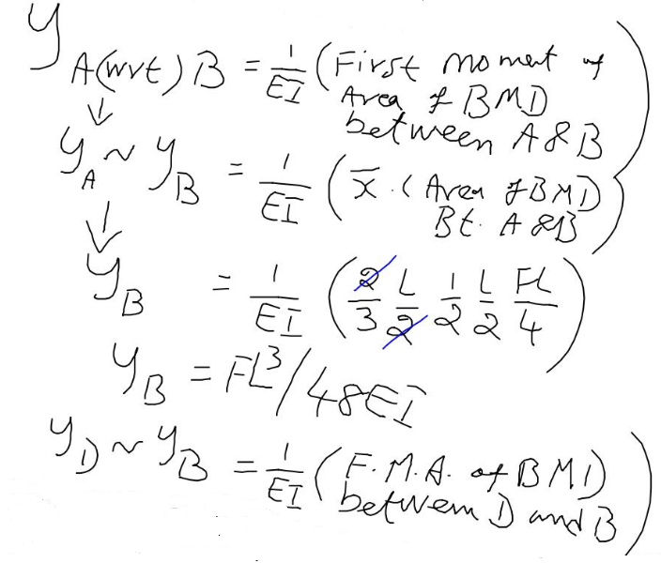

Slide 37
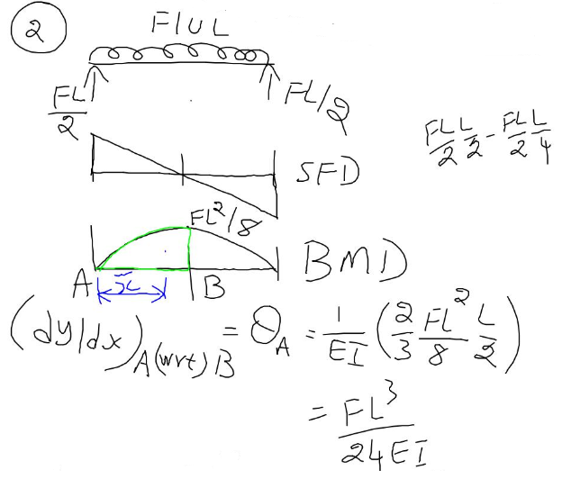
Parabola

Slide 38
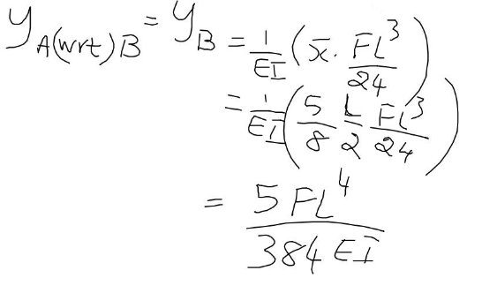

Slide 39
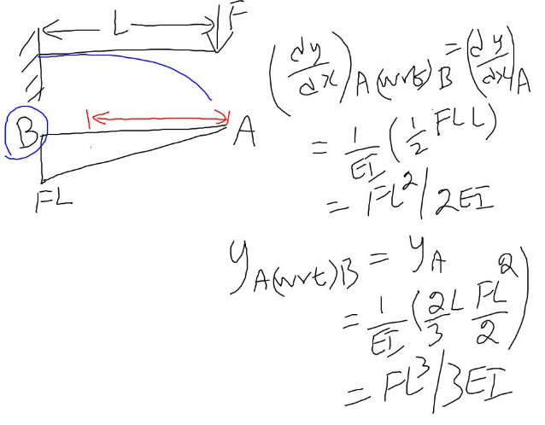

Slide 40
Conjugate (Pseudo) beam method
Loading of real beam
BC’s – there is a difference between simply supported end and fixed end
SFD of real beam
BMD of real beam
Loading of conjugate beam
Slope of real beam
SFD of conjugate beam
Deflection of real beam
BMD of conjugate beam

Slide 41
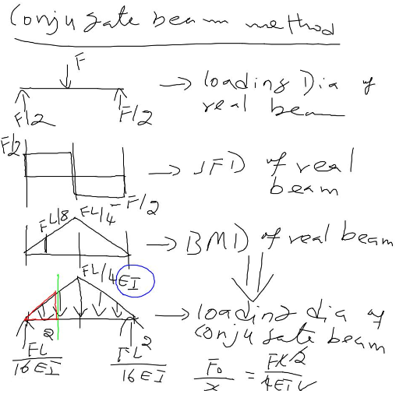
Conjugate (Pseudo) beam method

Slide 42
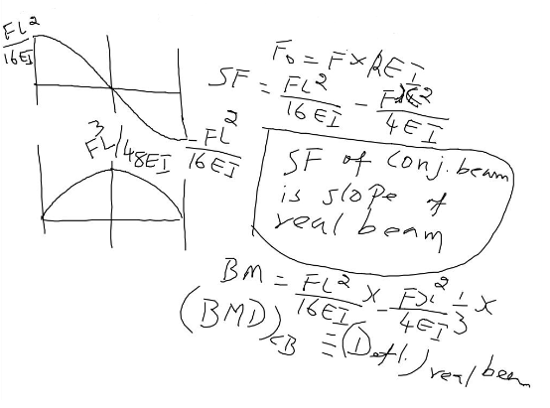

Slide 43
Thank You

